Slide 1

Server and Database
Installation of xampp server and mysql db
php-scripting language
Database connection
Registration page and login page using php
Faculty:
Mr. Sreedhar Aakula
CSE Dept,RGUKT-Basar

Slide 2
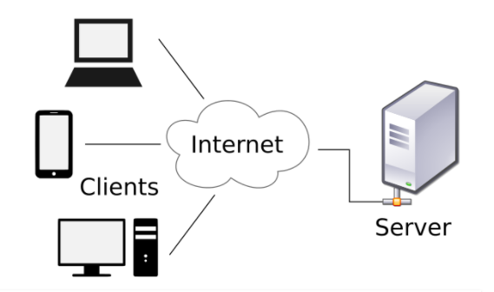
Client and Server Architecture:

Slide 3
What is a Client
A client can be a device or a program. A client device is a machine the end users use to access the web.
Desktops, laptops, smartphones, tablets are some examples of devices.
A client program is a program that allows the user to make requests through the web. One example is a web browser.
A user can request for a web page through a web browser. Moreover, the programs that can get online support, themes etc. can be also considered as clients.

Slide 4
What is server?
A server is a device that provides services to client requests. These devices run server programs. A single server can provide services to multiple clients simultaneously.
Usually, servers run continuously. There can be multiple servers in a single machine. It is also possible to have the client and the server in the same machine.
Any web site that uses server-side language requires a server to run.This server is always connected to the internet.
The five leading web servers in the market are:
1. Apache HTTP Server
2. Microsoft Internet Information Services
3. Lighttpd
4. Nginx Web Server
5. Sun Java System Web Server

Slide 5
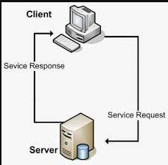

Slide 6
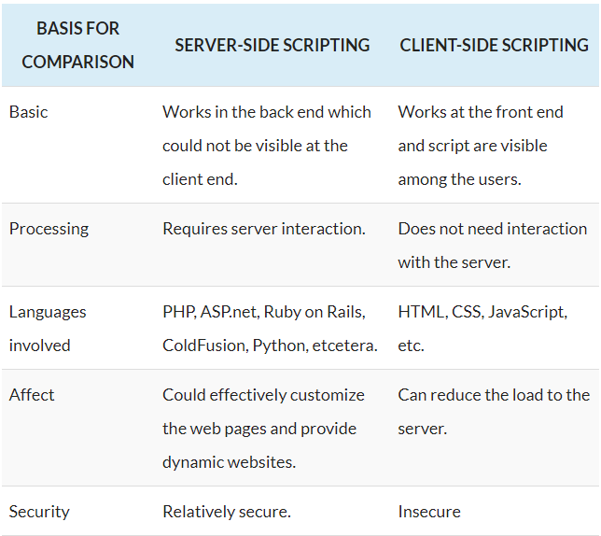
Difference between client and Server:

Slide 7
Intro. to Xampp Web Server:
XAMPP is one of the widely used cross-platform web servers, which helps developers to create and test their programs on a local webserver. It was developed by the Apache Friends.
XAMPP is an abbreviation where X stands for Cross-Platform, A stands for Apache, M stands for MYSQL, and the Ps stand for PHP and Perl, respectively.
XAMPP helps a local host or server to test its website and clients via computers and laptops before releasing it to the main server.
It is a platform that furnishes a suitable environment to test and verify the working of projects based on Apache, Perl, MySQL database, and PHP through the system of the host itself.

Slide 8
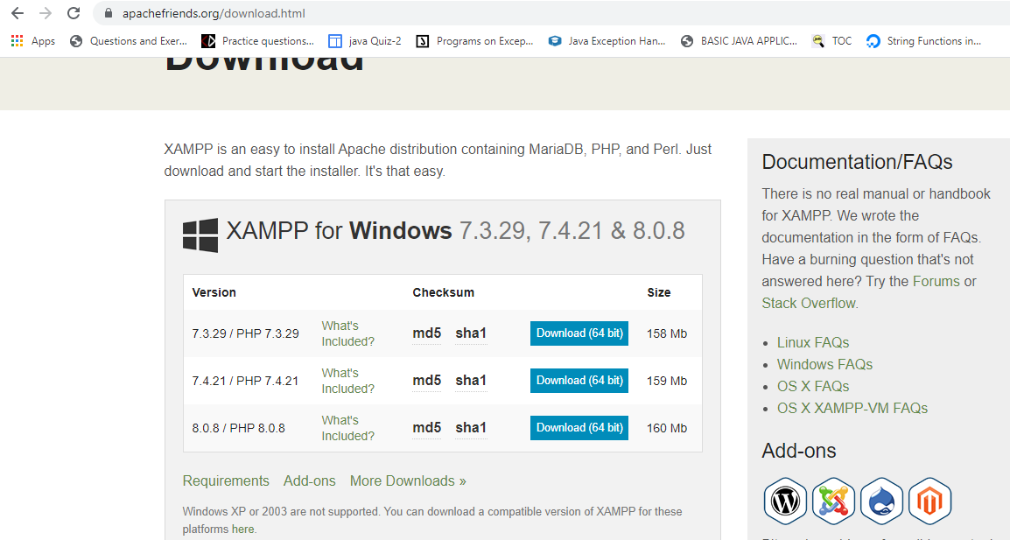

Slide 9
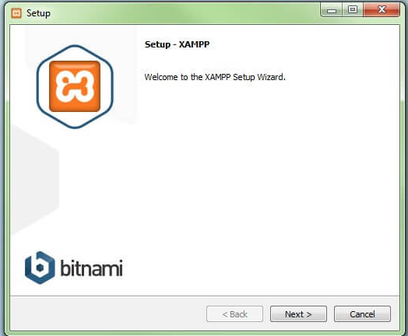
1.Start the setup wizard:

Slide 10
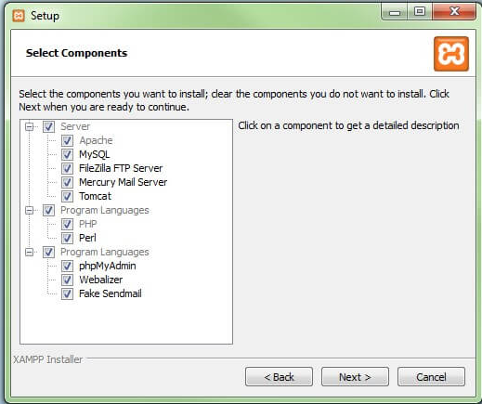
Choose software components:

Slide 11
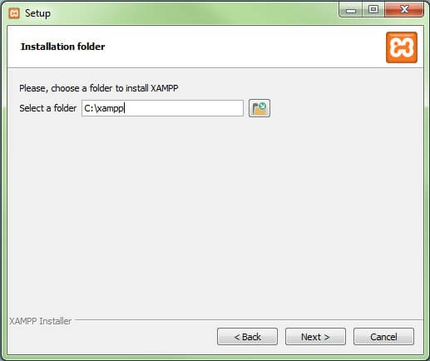
Choose the installation directory:

Slide 12
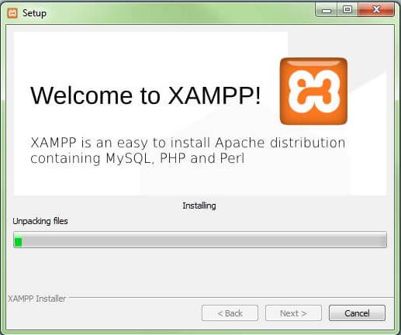
Start the installation process

Slide 13
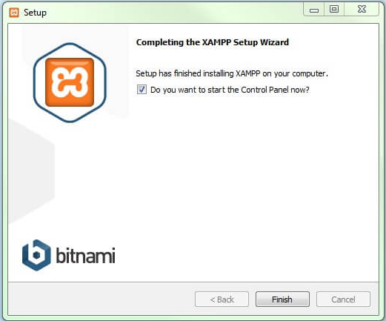
Complete installation

Slide 14
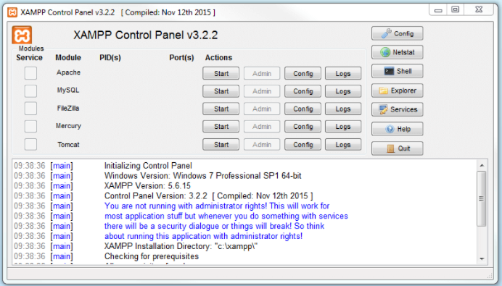
Xampp Control Panel:

Slide 15
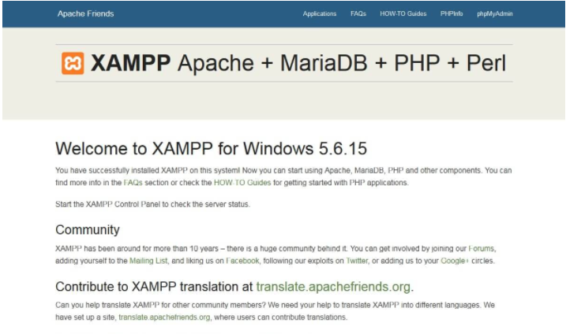
Module administration:
(http://localhost/dashboard/)

Slide 16
PHP-Hypertext PreProcessor:
PHP stands for Hypertext Preprocessor, which is an open source scripting language.
It is a server-side scripting language and a powerful tool for creating a dynamic and interactive website.
It is specially designed for server-side scripting, which executes on the server. PHP can be easily embedded with HTML files.
Advantages:
We can execute PHP code on different platform such as Windows, Linux, UNIX, Solaris, etc.
It is easy to use and learn.
PHP provides a built-in module which helps it to connect with the database easily.
PHP is an open source language that means it is available for free of cost.

Slide 17
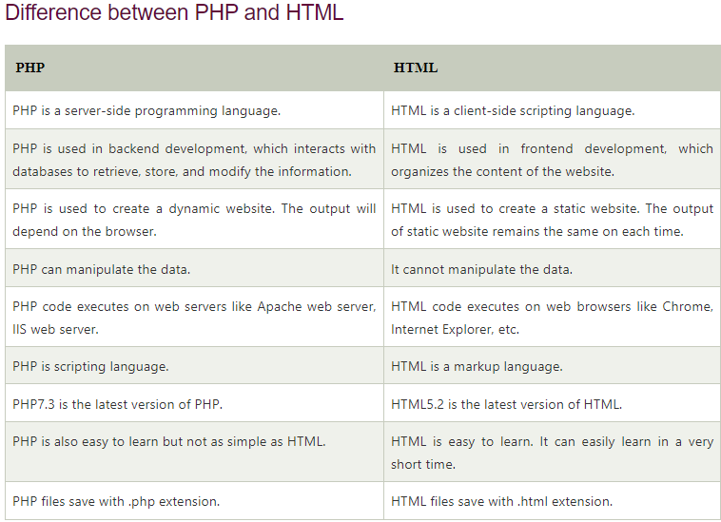

Slide 18
Phpmyadmin(mysql database):
It is the most popular application for MySQL database management. We can create, update, drop, alter, delete, import, and export MySQL database tables by using this software.
phpMyAdmin is a GUI-based application which is used to manage MySQL database. We can manually create database and table and execute the query on them. It provides a web-based interface and can run on any server.
phpMyAdmin also supports a wide range of operation like managing databases, relations, tables, columns, indexes, permissions, and users, etc., on MySQL and MariaDB.
These operations can be performed via user interface, while we still have the ability to execute any SQL statement.

Slide 19
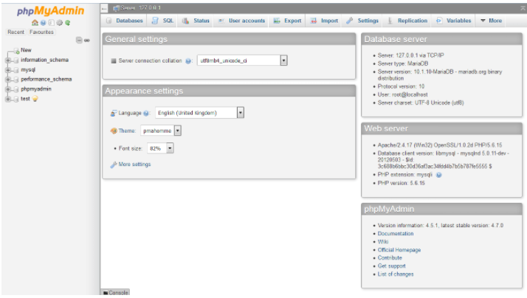
Phpmyadmin module:
(http://localhost/phpmyadmin/)

Slide 20
Database connection code in php:
<?php
$server="localhost:3307";
$username="root";
$password="";
$db="student_reg";
$conn=mysqli_connect($server,$username,$password,$db);
if(!$conn)
{
die("unable to connect");
}
?>

Slide 21
Thank you!!!
Queries..?

